Slide 1
Thinking outside the (black) box
Colin Gavaghan
Notes:
Probably the least “neuro” paper you’re going to hear!

Slide 2
NZLFCLPET
Centre for Artificial Intelligence & Public Policy (CAIPP)

Slide 3
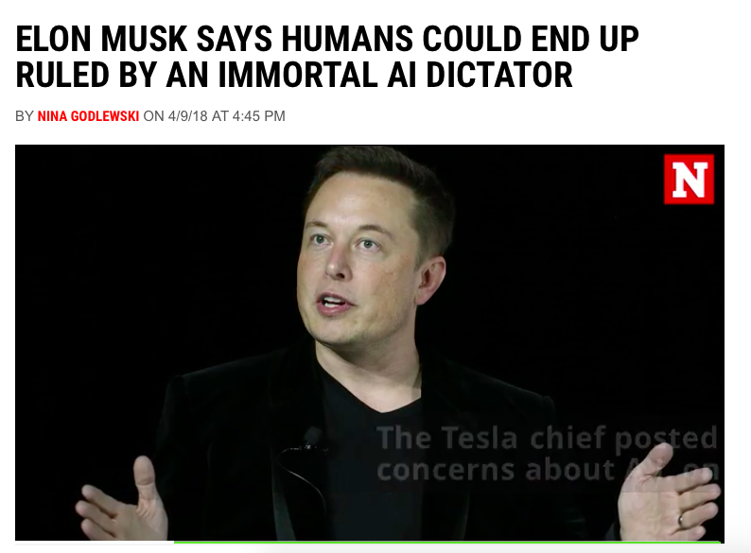

Slide 4
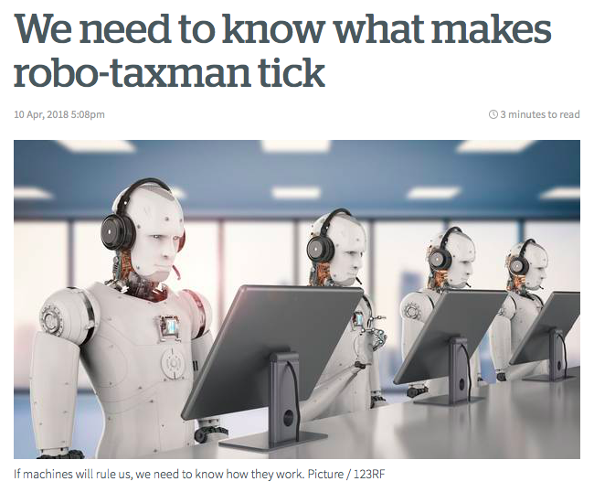

Slide 5
The ‘up’ side
More accurate
More efficient
Removes human bias

Slide 6
The ‘down’ side
Erosion of discretion
Less transparent
May replicate or reinforce bias (while giving impression of being unbiased.)
Notes:
Erosion of discretion

Slide 7
The ‘down’ side
Erosion of discretion
Less transparent
May replicate or reinforce bias (while giving impression of being unbiased.)
Notes:
Erosion of discretion

Slide 8
‘you cannot appeal to a WMD. That’s part of their fearsome power. They do not listen. Nor do they bend. They’re deaf not only to charm, threats, and cajoling but also to logic – even when there is good reason to question the data that feeds their conclusions.’
Notes:
Whether that’s a good or a bad thing will depend on a range of considerations. Discretion, after all, is the same mechanism that allows for nepotism and cronyism. But it’s definitely a ‘thing’

Slide 9
The ‘down’ side
Erosion of discretion
Less transparent
May replicate or reinforce bias (while giving impression of being unbiased.)

Slide 10
Less transparent because
Algorithms are proprietary
Machine learning doesn’t work that way

Slide 11
Wisconsin v Loomis (2015)
‘Northpointe, Inc., the developer of COMPAS, considers COMPAS a proprietary instrument and a trade secret. Accordingly, it does not disclose how the risk scores are determined or how the factors are weighed.’
Notes:
Based on due process right.

Slide 12
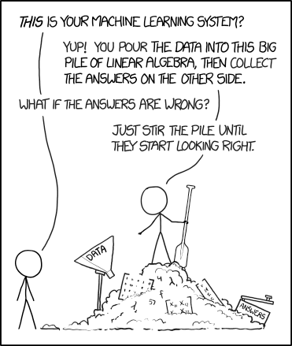

Slide 13
The ‘down’ side
Erosion of discretion
Less transparent
May replicate or reinforce bias (while giving impression of being unbiased.)

Slide 14
‘Human biases and values are embedded into each and every step of development. Computerization may simply drive discrimination upstream.’

Slide 16
False positives
‘Black defendants who did not reoffend… were nearly twice as likely to be misclassified as higher risk compared to their white counterparts (45 percent vs. 23 percent)’.
'white defendants who reoffended… were mistakenly labeled low risk almost twice as often as black reoffenders (48 percent vs. 28 percent)’.

Slide 17
Regulatory/governance measures
Individual rights models
Independent agencies and regulators
Self-regulatory models (e.g. ALGO-CARE, PHRaE)
Design-based models (XAI)
Education and training

Slide 18
Individual rights models
General rights around privacy, discrimination, etc
Right to an explanation
Right to a human decision-maker

Slide 21
Is a comprehensible explanation always possible?
The resulting systems can be explained mathematically, however the inputs for such systems are abstracted from the raw data to an extent where the numbers are practically meaningless to any outside observer.
Dr Janet Bastiman, evidence to UK Parliament Science and Technology Ctte (2017)
Notes:
Maybe the answer is to say: if you can’t explain it, don’t use it.

Slide 22
New Zealand?
Transfer process between debt collector and credit reporter is an automated process. To comply with the accuracy aspect of principle 8, a manual notation has to be added to the record.
But unable to show that breach of principle 8 caused her any harm.
PCC276 Case Note 205558 [2010] NZPrivCmr 1

Slide 23
Should we be reassured by a ‘human in the loop’?
False reassurance - human ‘decision-makers’ will unthinkingly defer to the machine because of ‘automation bias’
Worse decisions - when they don’t, they might make worse decisions that at present because of ‘judgmental atrophy’

Slide 24
“Automation bias”
‘It remains to be seen, however, how an algorithm might influence custody officer decision-making practices in future. Might some (consciously or otherwise) prefer to abdicate responsibility for what are risky decisions to the algorithm, resulting in deskilling and ‘judgmental atrophy’? Others might resist the intervention of an artificial tool. Only future research will determine this.’
Oswald, Grace, Urwin and Barnes (2017)

Slide 25
Notes:
We know that we are all – or mostly – subject to cognitive biases that cause us to amplify rare, newsworthy events, and discount the more common. We know that people worry about air crashes more than they worry about the taxi ride to the airport, despite what actuarial data would tell us. What I want to mention briefly is the possibly false reassurance that comes from having a ‘human in the loop’
We now – because experts in human factors and psychology can show us – that the reaction time of a supervisor is markedly slower than the reaction time of an active player. We know that staying in an inert but alert state is all-but impossible for prolonged periods, especially as a task grows more familiar. We suspect, strongly, that automation bias can contribute to an erosion of decision-making capacities, and ‘judgmental atrophy.’ All of this makes me pretty concerned about the intermediate status of semi-autonomous cars. At best, they’re likely to offer false reassurance. At worst, they’re likely to result in humans being called upon to make decisions in highly non-optimal circumstances, that may well be worse than leaving it to the AI.

