Slide 1
Mandatory Data Breach Notification: Lessons Learned
INFORMATION & PRIVACY GOVERNANCE SOLUTIONS
Susan Bennett, Principal | Sibenco Legal & Advisory
e: susan.bennett@sibenco.com | p: +61 2 8226 8682 | www.sibenco.com
@sibenco | @infogovanz
©2018 Sibenco Pty Ltd

Slide 2
Global Overview - EU
Notification must be made where a data breach is likely to ‘result in a risk for the rights and freedoms of individuals’.
Notification must be made within 72 hours of first having become aware of the breach
Data processors are required to notify their customers and the controllers ‘without undue delay’ after first becoming aware of a data breach.

Slide 3
Global Overview - US
California – 2002
50 States have now passed mandatory data breach notification legislation
District of Columbia, Guam, Puerto Rico and US Virgin Islands
Few States impose a specific timeframe for notification
Florida - within 30 days
Ohio and Wisconsin – within 45 days.

Slide 4
Global Overview - Canada
Mandatory data breach notification comes into force on 1 Nov 2018 under the Personal Information Protection and Electronic Documents Act (PIPEDA)
Notification where it is reasonable to believe that the breach creates a ‘real risk of significant harm to the individual’.
‘significant harm’ includes - bodily harm, humiliation, damage to reputation or relationships, financial loss, identity theft, negative effects on the credit record and damage to, or loss of, property.

Slide 5
Asia – Mandatory Notification
Australia
South Korea - only if more than 10,000 records
Taiwan – notification only affected individuals
Philippines
involve sensitive personal information or information that may be used to commit identity fraud
standard of a ‘real risk” of serious harm, rather than a likelihood of serious harm as in Australia.
mainland China
Indonesia

Slide 6
Asia – Singapore
Cybersecurity Act requires owners of designated ‘critical information infrastructures’ to report cybersecurity threats or incidents to the Singapore Cyber Security Agency
Personal Data Protection Act Consultation include draft proposals to introduce mandatory data breach notifications in Singapore
‘any risk of impact or harm to the affected individuals’ and for data breaches of significant scale involving 500 or more individuals, even if the breach doesn’t pose a risk of harm.

Slide 7
Asia – Hong Kong
Voluntary notification to affected individuals concerned, the Privacy Commissioner and other regulators when a real risk of harm is reasonably foreseeable.
Guidance Note on ‘Data Breach Handling and the Giving of Breach Notifications.
Guidance Notes issued by the Hong Kong Monetary Authority for banking and finance.

Slide 8
Australia - NDB Scheme Feb 2018
Requires organisations to notify individuals whose personal information is involved in a data breach that is likely to result in serious harm and the Australian Information Commissioner.

Slide 9
Australia – serious harm
OAIC says ‘assess the risk of serious harm holistically’.
The NDB scheme includes a non-exhaustive list of ‘relevant matters’ set out in section 26WG.
Whether security technology was used and designed to make the information unintelligible or meaningless to unauthorised persons.

Slide 10
Take Remedial Action
If an organisation takes remedial action so that the data breach would not be likely to result in serious harm, then the breach is not an eligible data breach and notification is unnecessary.
Section 26WF(1)-(3)

Slide 11
NDB Scheme
to comply with NDB Scheme
Ensure that breach response plans are up to date
There is an appropriate assessment process for suspected eligible data breaches

Slide 12
Data Breach Notification since 23 Feb 2018
OAIC reported on 11 April 2018:
63 data breaches notified to 31 March
Compared with 114 total for last year
Health sector comprised 24% of notifications (& ranked no.1 in top 5 sectors)

Slide 13
Causes of Data breaches since 23 Feb 2018

Slide 14
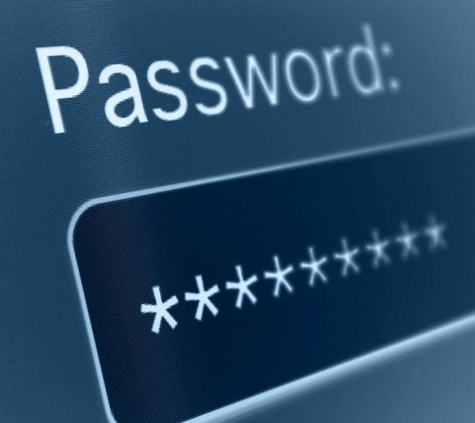
Major Data Breaches - Lessons Learned
Preventable Data Breaches – human error, passwords, patches not updated, known problems with technical system
Communication problems – internal & external
Legal & Reputational – ongoing
Costs – direct, indirect & ongoing

Slide 15
US – Equifax, Sept 2017
144 million customer financial records
6 weeks to notify breach
Insider trading
Tweet – ‘Happy Friday’
Offered own ID theft protection program for free but customers who did so waived their legal rights.

Slide 16
UK - TalkTalk, 2015
Largest Fine by ICO - £400k
Information Commissioner, Elizabeth Denham, said that TalkTalk’s ‘failure to implement the most basic cybersecurity measures allowed hackers to penetrate systems with ease’.
Initial responses increased TalkTalk’s problems and client anger – e.g slow identification of total data loss.
TalkTalk calculated that the breach cost it more than £80 million.

Slide 17
CBA - Australia
Potential data breach of 20 million account details from 2000 - to early 2016
CBA hired Fuji Xerox to decommission a data storage centre incl destruction of back-up magnetic tape drives of customers’ financial statements in 2016.
CBA afterwards realised it didn’t have the certificate to prove tapes had been destroyed.
Informed OAIC.

Slide 18
Data Breach Notification – Key Points
Be proactive, prepared and able to quickly respond
Ensure Data Breach Response Plan is up to date
Review Mandatory Data Breach notification requirements
Prepare/review template data breach notification
Carry out PIAs & Info Security risk assessments
Train staff responsible for handling personal information
Communicate effectively & accurately

