Slide 1
Measuring Privacy Maturity Across Government: A case study
Russell Burnard
Government Chief Privacy Officer
15 December 2016

Slide 2
2012-14
Paving the way
2014
GCPO established
2015-16
First annual report
2017 -Continue to build resilient practices
2016 Results
GCPO Timeline

Slide 3
Paving the way: 2012-2014
2012: GCIO conducted a Review of Publicly Accessible Information Systems
2013: Information Privacy and Security Programme established
2014: Government Chief Privacy Officer established under the GCIO all-of-government mandate.
2014: New Zealand Protective Security Requirements established
Notes:
.

Slide 4
2012-14
Paving the way
2014
GCPO established
GCPO Timeline

Slide 5
2014 GCPO appointed
Mandate
Ensure a long-term focus on privacy management and building privacy capability across the State services
Foundations
Privacy Maturity Assessment Framework (PMAF)
Core Expectations
Report Annually to the Minister of State Services
on system-wide capability; and
how improvements are being leveraged to enable effective sharing and use of data and information for the broader benefit of government and New Zealanders.
Scope and Mandate

Slide 6
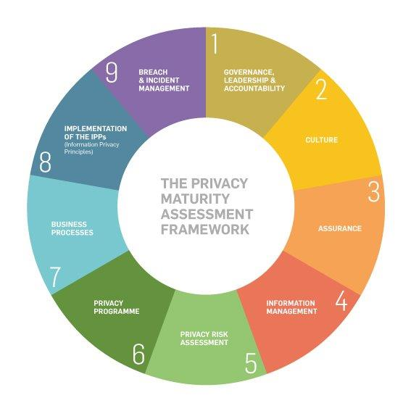

Slide 7
2012-14
Paving the way
2014
GCPO established
2015-16
First annual report
GCPO Timeline

Slide 8
Reporting Methodology
Based on the PMAF and Core Expectations
Self-assessment and target setting based on understanding of risks
Encouraged tough realistic assessments rather than wishful thinking
Goal: Establish a new baseline for future reporting

Slide 9
2012-14
Paving the way
2014
GCPO established
2015-16
First annual report
2016 Results
GCPO Timeline

Slide 10
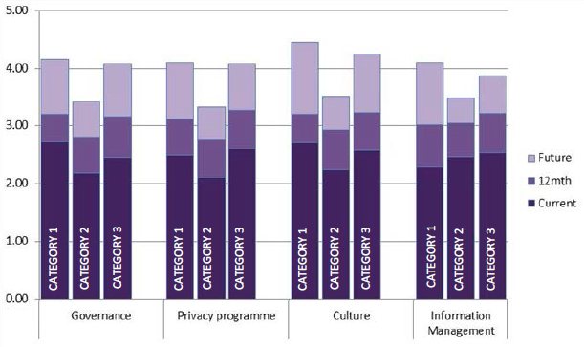
2016 Results
This graph depicts agency-defined current, short term (12 month) and long term (three to five years) privacy maturity targets in key indicators.
Category 1: Agencies with a large and/or complex amount of personal information that may be held for different functions and purposes.
Category 2: Agencies with a small amount of personal information, or information collected for single purpose.
Category 3: District Health Boards.

Slide 11
2012-14
Paving the way
2014
GCPO established
2015-16
First annual report
2017 -Continue to build resilient practices
2016 Results
GCPO Timeline

Slide 12
2017 Onwards
Continue to work with agencies to ensure ongoing improvements in system-wide capability and maturity in privacy
Refine our work programmes based on analysis of the self-assessments
Focus on information management and security in agencies with large and varied data sets, and the DHBs
Incorporate Kiwis Count results to give the citizen perspective

Slide 13
References
DIA NZSIS Report 2016 http://www.ssc.govt.nz/sites/all/files/State%20Services%20briefing%20to%20Minister%20Bennett.pdf
GCPO Guidance & Resources including PMAF and Core Expectations https://www.ict.govt.nz/guidance-and-resources/privacy/
SSC Kiwis Count Survey http://www.ssc.govt.nz/kiwis-count
Information Privacy and Security Programme: Final Report https://www.ssc.govt.nz/sites/all/files/SEC-15-SUB-0005.pdf
GCIO Review of Publicly Accessible Systems: Summary of Findings December 2012 https://www.ssc.govt.nz/sites/all/files/gcio-review-publicly-accessible-systems.PDF

Slide 14
Questions?
GCPO@DIA.GOVT.NZ

